Slide 1

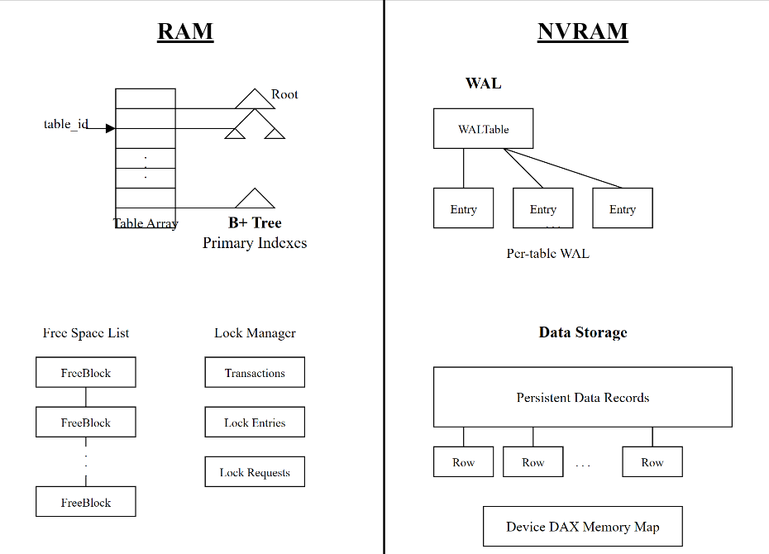
Design and Implementation of a Relational Database using RAM and Non-Volatile Memory
Anushka Srivastava (2201030) & Jaswindar Singh Gill (2201099)
Abstract
NVRAM-optimized database leveraging byte-addressability and persistence characteristics. Hybrid memory architecture: index while ensuring ACID transaction structures in volatile RAM, data in NVRAM. Eliminates I/O bottlenecks, reduces complexity while ensuring data durability without traditional buffer management.
Research Question
To develop a high-performance relational database system that exploits NVRAM characteristics to enhance throughput and durability while maintaining ACID properties.
Method
We developed an NVRAM-optimized database with these key components:
Hybrid architecture: RAM (indexes) + NVRAM (data)
Custom free space manager (linked-list based) for byte-addressable memory
B+ tree with direct NVRAM pointers
Optimized WAL using Intel persistence instructions
Multi-granular lock manager
Device DAX namespace simulation
Innovation: WAL stores pointers not data blocks, uniquely possible with byte-addressability.
Overview of Data Structures Used
Results
Our NVRAM-optimized database consistently outperforms Redis across all YCSB workloads:
Throughput Comparison (operations/second):
Conclusion
Key Insights on Performance:
Direct Pointer Access: Eliminating serialization provides substantial performance gains
Pointer-Based WAL: Logging pointers instead of data blocks reduces write amplification
Optimal Read Performance: Greatest advantage (3.21×) observed in read-only scenarios
Efficient Memory Management: Custom free space manager dramatically reduces overhead
Workload Type | NVRAM-DB | Redis | Improvement
Load Phase | 11,494 | 9,009 | 1.28×
Workload A (50% read/50% update) | 29,412 | 12,658 | 2.32×
Workload B (95% read/5% update) | 32,258 | 11,628 | 2.77×
Workload C (100% read) | 35,714 | 11,111 | 3.21×
Workload D (95% read/5% insert) | 31,250 | 11,905 | 2.62×
Latency Comparison (microseconds)
Operation Type | NVRAM-DB | Redis | Improvement
Read Operations (Workload C) | 46.99 | 168.79 | 3.6×
Update Operations (Workload A) | 79.93 | 110.89 | 1.4×
Insert Operations (Workload D) | 218.67 | 428.09 | 2.0×
Cleanup Overhead | 1.5-4.0 | 234-720 | 58-180×

